Slide 1
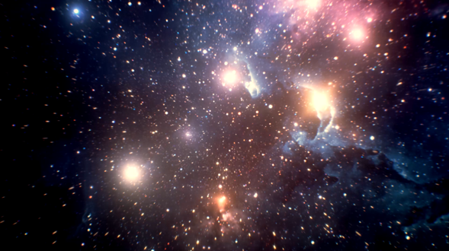
Galaxy Morphology "Classification"
Zach Anderson, Kali Schoenrock, and Jason Stone

Slide 2
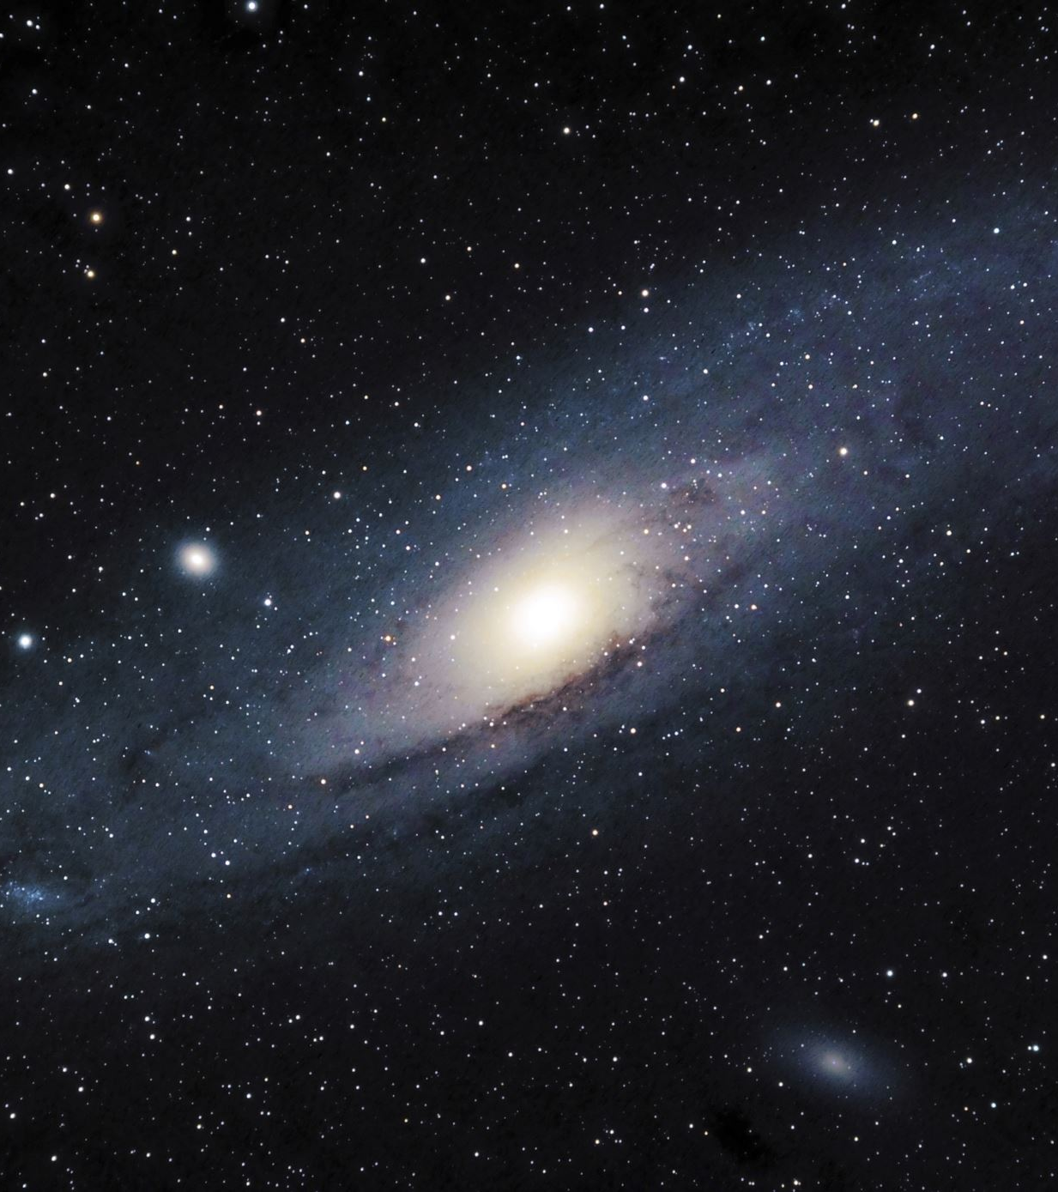
Data and Sources :
Data: Galaxy Zoo 2
Images: Sloan Digital Sky Survey
https://data.galaxyzoo.org/#section-12
gz2_hart16.csv (364 MB)
https://zenodo.org/record/3565489#.Y3vFKS-l0eY
gz2_filename_mapping.csv (13 MB)
images_gz2.zip (3.4 GB)

Slide 3
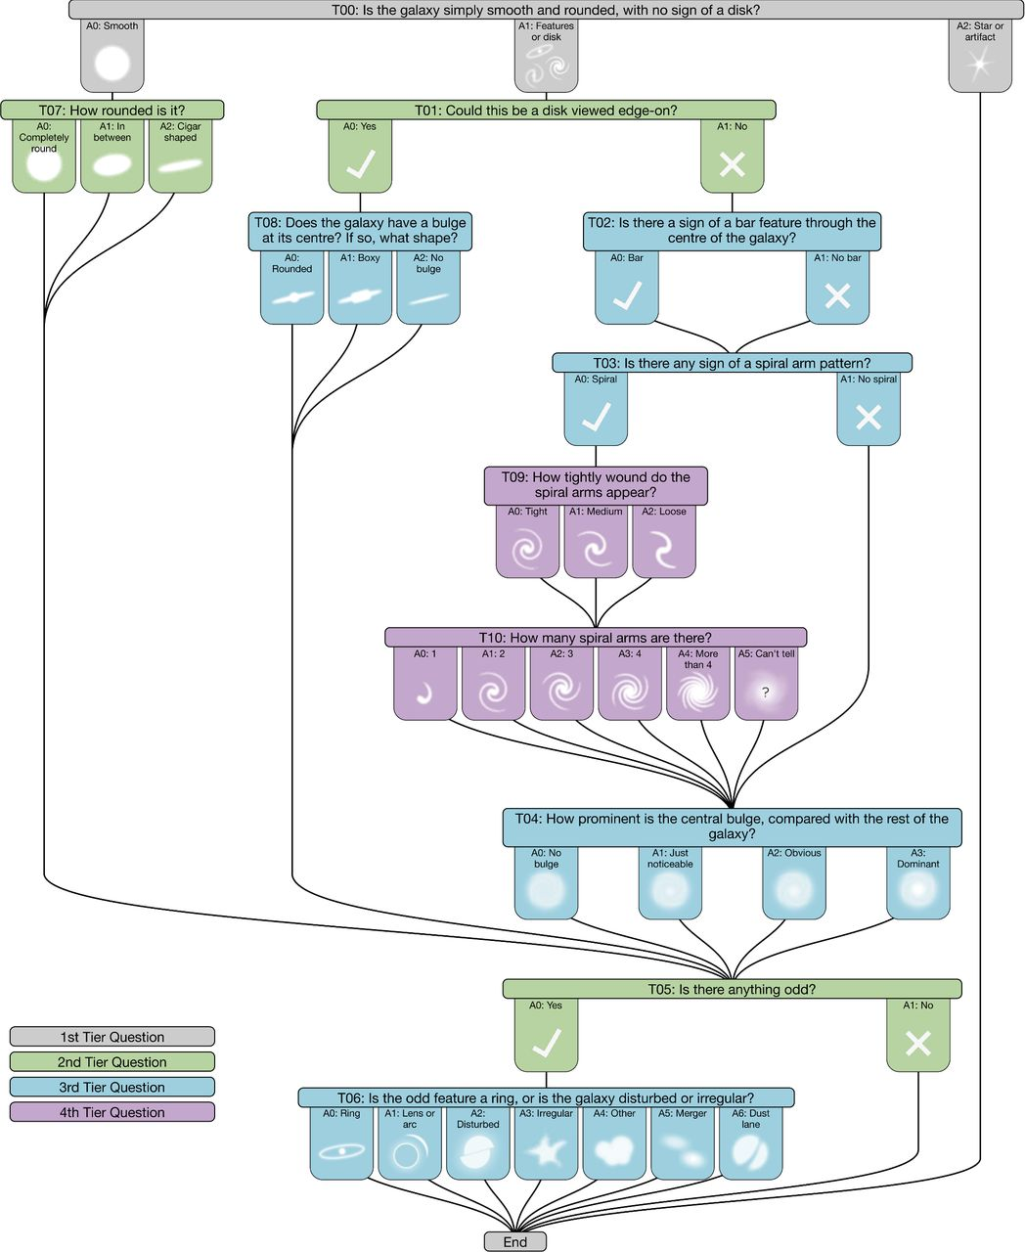
This question tree is what was used to create the 37 targets for the model. Each target is a potential morphological feature of a galaxy.

Slide 4
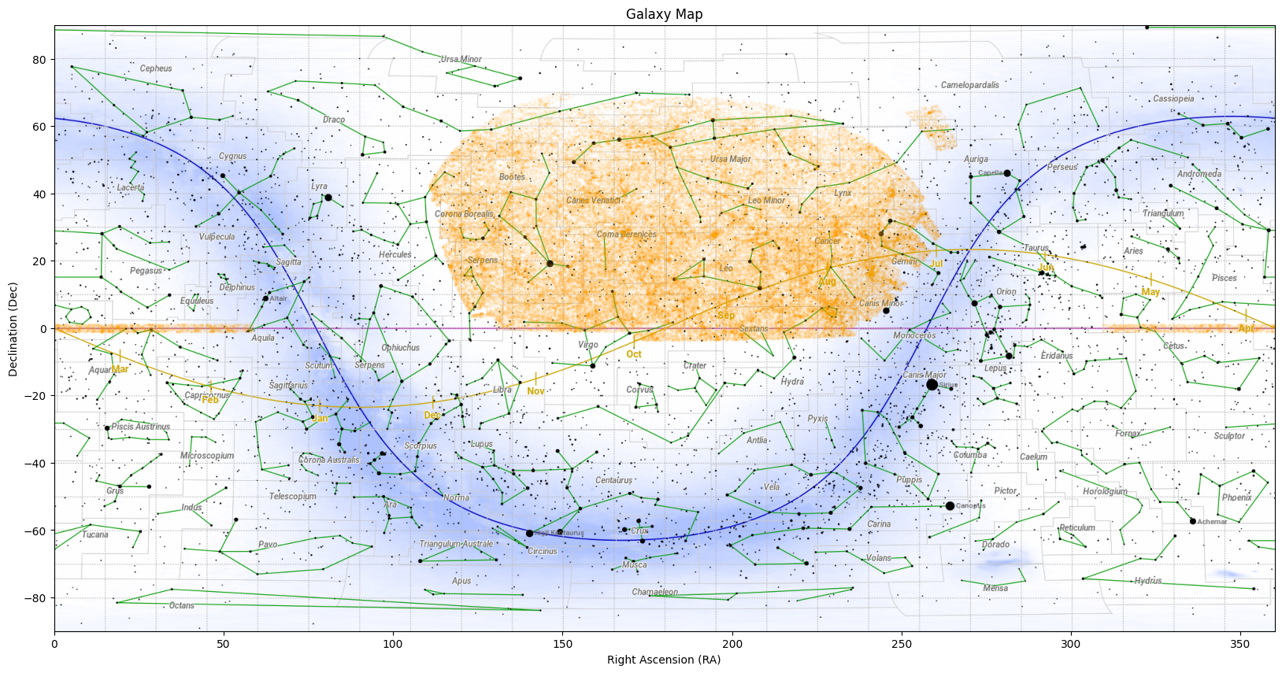

Slide 5
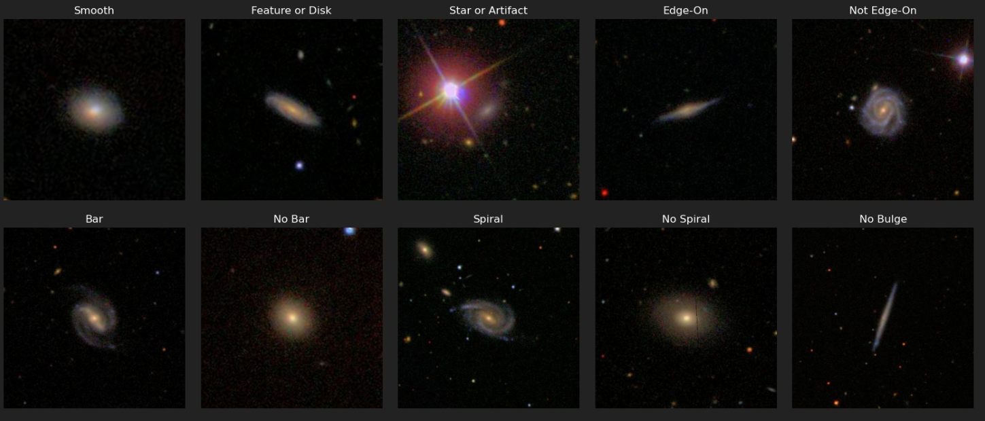
Examples of Data Images & Categories

Slide 6
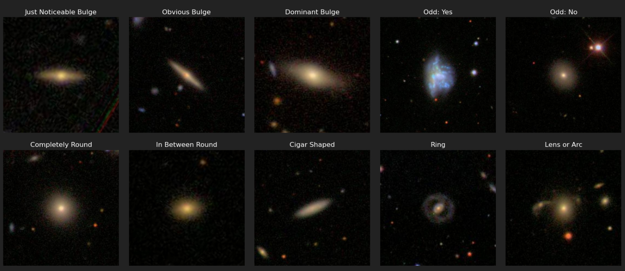
Examples of Data Images & Categories

Slide 7
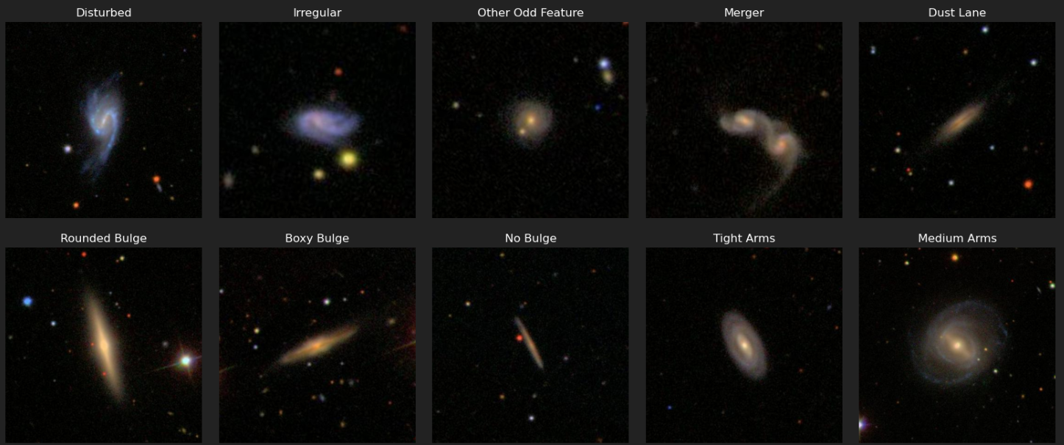
Examples of Data Images & Categories

Slide 8
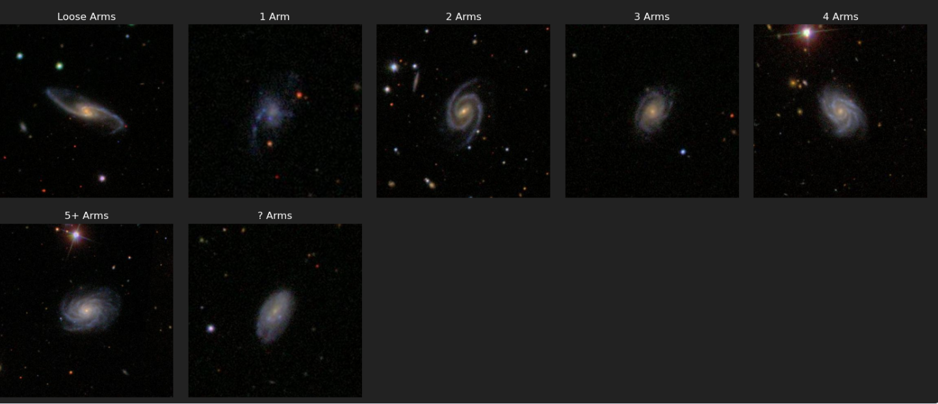
Examples of Data Images & Categories

Slide 9
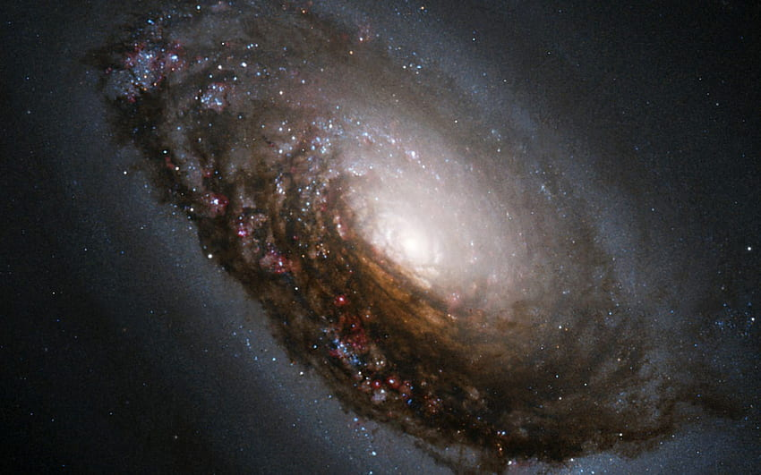
Process
Imported 2 CSV files into Pandas
Removed duplicate and missing value rows
Removed rows without an image
Saved to an SQL Database

Slide 10
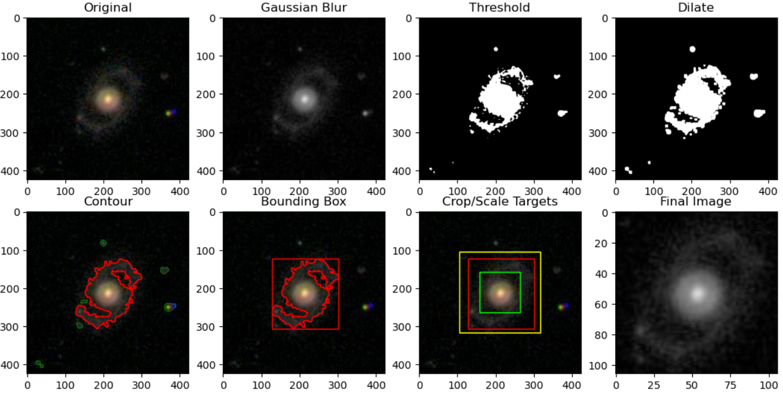
Processing Images

Slide 11
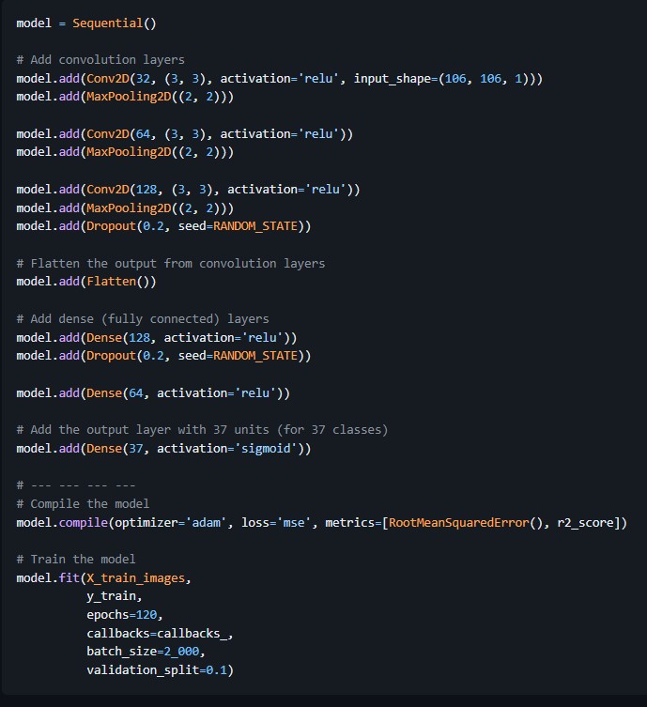
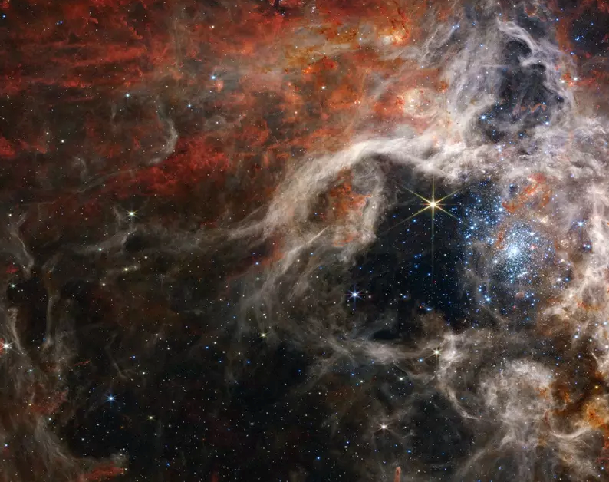
Convolutional Neural
Network Model

Slide 12
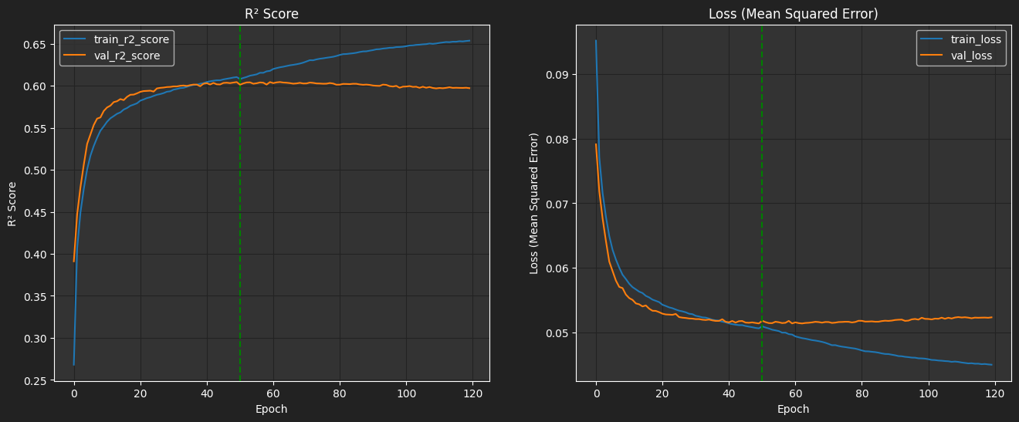
Training
The vertical green line is our final model. Everything after it was overfit.

Slide 13
